Slide 1

Choose the Best Areas in Lake Erie for Smallmouth Bass Fishing
Presented by : Zhongyu Zhou

Slide 2
Overview
Introduction
Research Area
Data
Methodology
Process
Results
Reference

Slide 3
Introduction
Bass fishing is very popular in the United States, with various bass fishing competitions held every year.
Lake Erie has an abundance of smallmouth bass and is a good habitat for them.
Personal hobby, I like fishing, especially lures

Slide 4
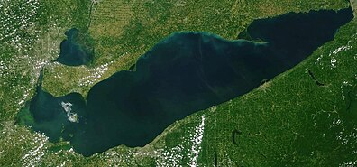
Research Area
Lake Erie

Slide 5
Data
bathymetry data from NOAA (raster data)
Shoreline data from NOAA and Environment Canada (vector data)
Substrate data from USACE (raster data)
Averaged water temperature data from NOAA (raster data)
Fish species locations data from USGS (vector data)

Slide 6
Data
Dependent variable:
Smallmouth bass presence (1/0)
Independent variables:
Continuous: water temperature, food(Emerald Shiner), water depth(dem)
Category: substrate

Slide 7
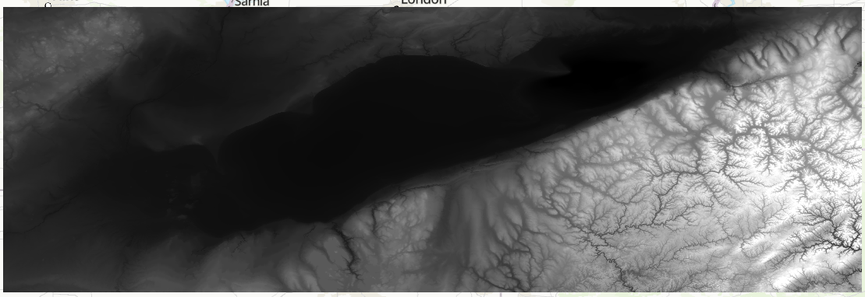
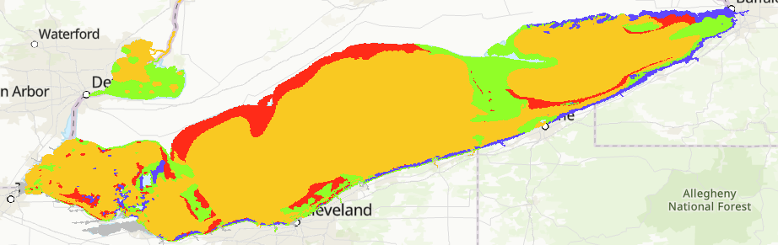
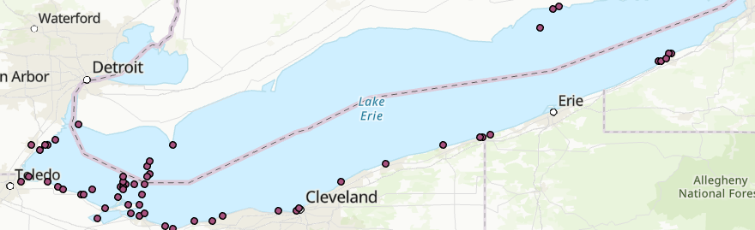
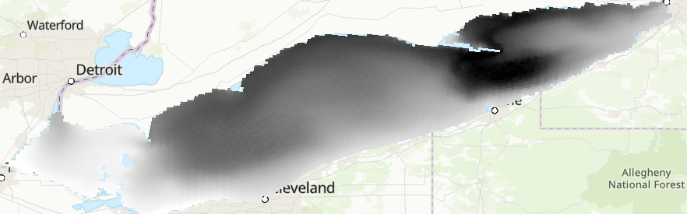
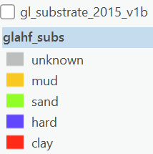
Data

Slide 8
Methodology
Create random points
Raster Calculator
Extract value to points
T-test
Chi-square test
Logistic Regression
Reclassify
…

Slide 9
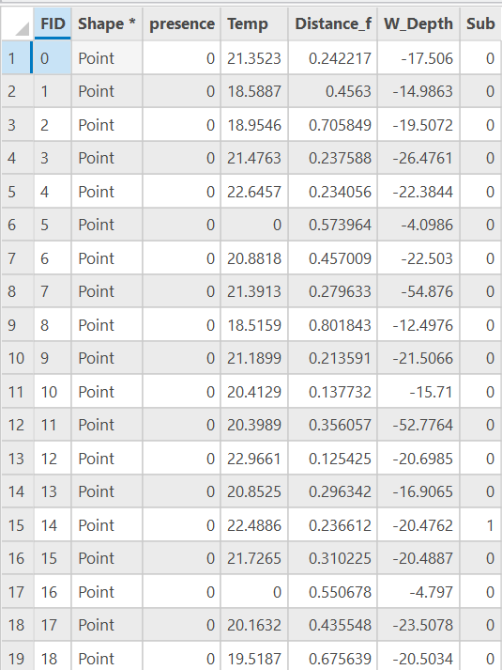
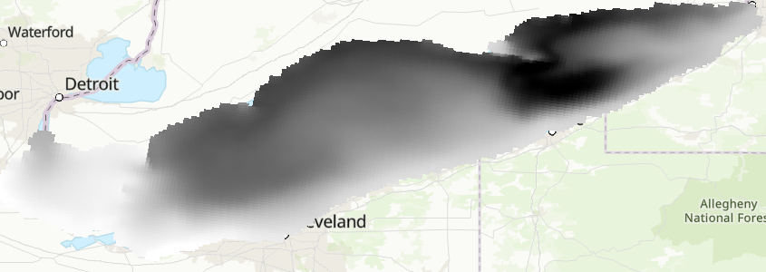
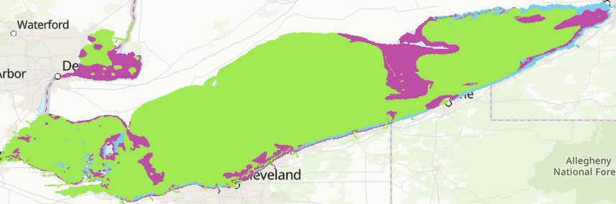
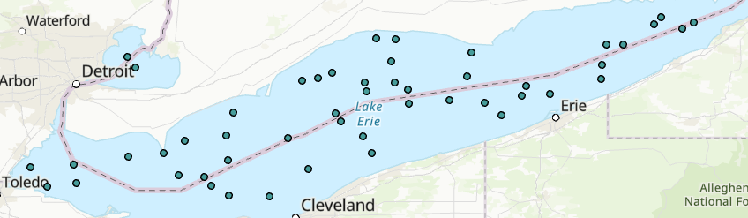

Process – Data preprocessing

Slide 10
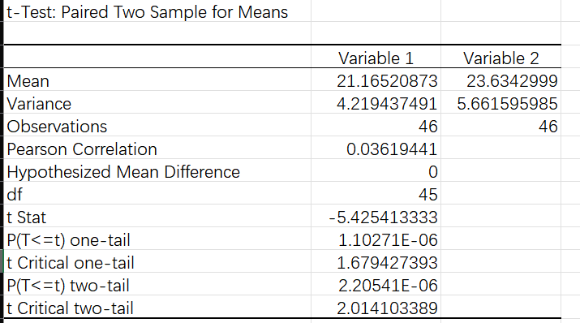
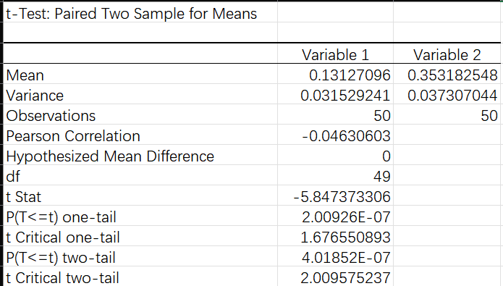
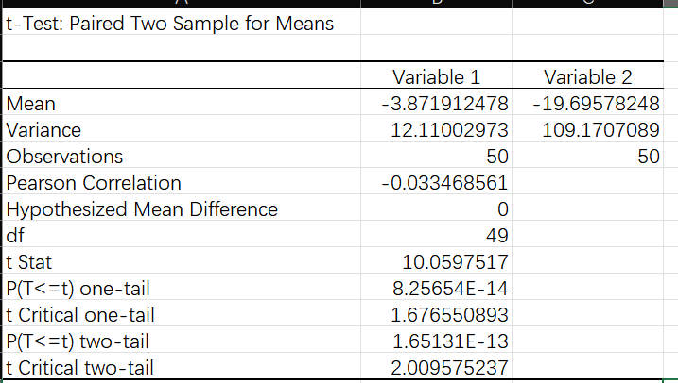
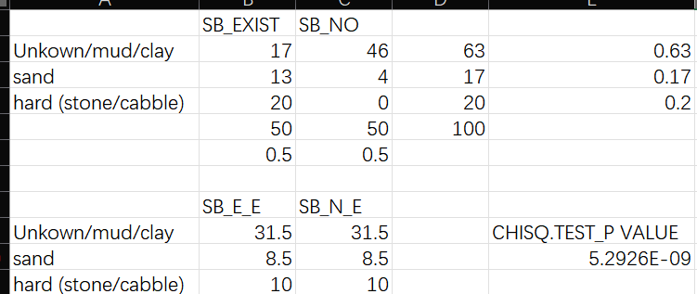
Process - Statistical Testing
If P value < Alpha value 0.05, then reject the null hypothesis.
Null hypothesis: there is no significant difference in slope degree between the two data.

Slide 11
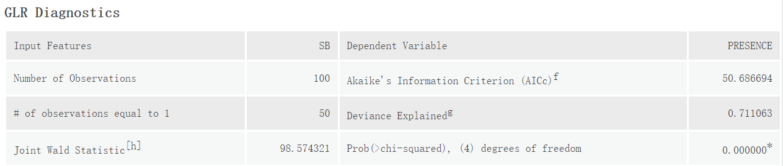
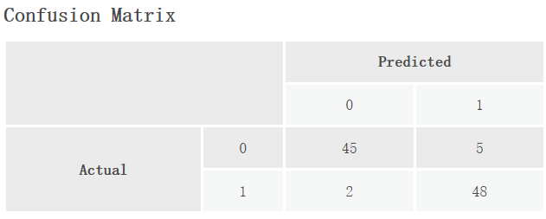
Result
Overall accuracy = (45+48)/100 = 0.93

Slide 12
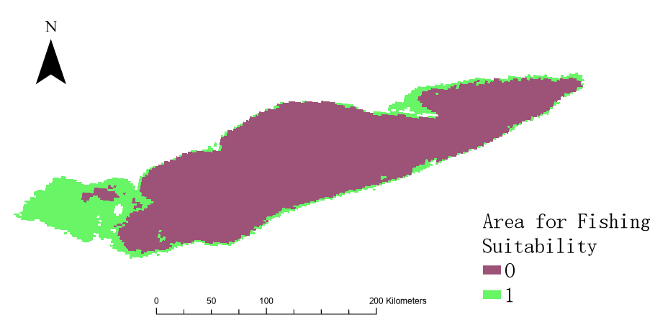
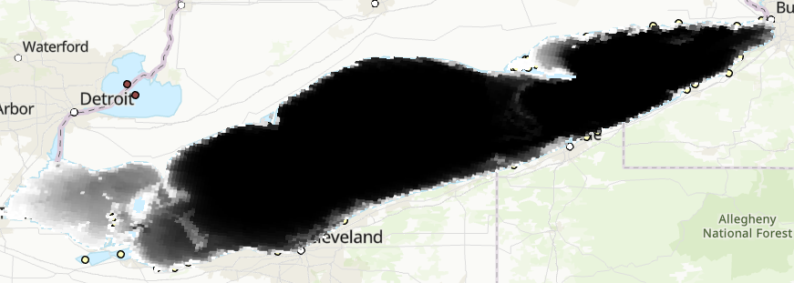
Result

Slide 13
Reference
1. Olson, M. H., Young, B. P., & Blinkoff, K. D. (2003). Mechanisms underlying habitat use of juvenile largemouth bass and smallmouth bass. Transactions of the American Fisheries Society, 132(2), 398-405.
2. Todd, B. L., & Rabeni, C. F. (1989). Movement and habitat use by stream‐dwelling smallmouth bass. Transactions of the American Fisheries Society, 118(3), 229-242.
3. George, E. L., & Hadley, W. F. (1979). Food and habitat partitioning between rock bass (Ambloplites rupestris) and smallmouth bass (Micropterus dolomieui) young of the year. Transactions of the American Fisheries Society, 108(3), 253-261.
4. Hubert, W. A., & Lackey, R. T. (1980). Habitat of adult smallmouth bass in a Tennessee River reservoir. Transactions of the American Fisheries Society, 109(4), 364-370.
5. Doan, K. H. (1940). Studies of the smallmouth bass. The Journal of Wildlife Management, 4(3), 241-266.
6. Probst, W. E., Rabeni, C. F., Covington, W. G., & Marteney, R. E. (1984). Resource use by stream-dwelling rock bass and smallmouth bass. Transactions of the American Fisheries Society, 113(3), 283-294.
…

